Slide 1
CS 161
Design and Architecture of Computer Systems
Lecture 2
Instructor: L.N. Bhuyan
(http://www.engr.ucr.edu/faculty/cs/bhuyan.html)
Notes:
Give qualifications of instructors:
DAP
teaching computer architecture at Berkeley since 1977
Co-athor of textbook used in class
Best known for being one of pioneers of RISC and RAID
Member of NAE

Slide 2
What is “Computer Architecture”?
Application (Netscape)
Operating System
Compiler
(Unix;
Windows 9x)
Software
Assembler
Instruction Set
Architecture
Hardware
Processor
Memory
I/O system
Datapath & Control
Digital Design
Circuit Design
CS 161
transistors, IC layout
Key Idea: levels of abstraction
  hide unnecessary implementation details
  helps us cope with enormous complexity of real systems

Slide 3
What is “Computer Architecture”?
Computer Architecture =
Instruction Set Architecture (ISA)
    the one “true” language of a machine
    boundary between hardware and software
    the hardware’s specification; defines “what” a machine does;
    +
    Machine Organization
    the “guts” of the machine; “how” the hardware works; the implementation; must obey the ISA abstraction
We will explore both, and more!

Slide 4
Levels of Abstraction
temp = v[k];
v[k] = v[k+1];
v[k+1] = temp;
High Level Language Program (e.g., C)
Compiler
lw $15, 0($2)
lw $16, 4($2)
sw $16, 0($2)
sw $15, 4($2)
Assembly Language Program (e.g.,MIPS)
Assembler
0000 1001 1100 0110 1010 1111 0101 1000
1010 1111 0101 1000 0000 1001 1100 0110
1100 0110 1010 1111 0101 1000 0000 1001
0101 1000 0000 1001 1100 0110 1010 1111
Machine Language Program (MIPS)
Machine Interpretation
Datapath Transfer Specification
IR <− Imem[PC]; PC <− PC + 4
°
°
reasons to use HLL language?

Slide 5
Execution Cycle
Obtain instruction from program storage
Instruction
Fetch
Instruction
Decode
Determine required actions and instruction size
Operand
Fetch
Locate and obtain operand data
Execute
Compute result value or status
Result
Store
Deposit results in storage for later use
Next
Instruction
Determine successor instruction

Slide 6
Ch2: Instructions
Language of the Machine
More primitive than higher level languages
e.g., no sophisticated control flow
Very restrictive e.g., MIPS Arithmetic Instructions
We’ll be working with the MIPS instruction set architecture
  similar to other architectures developed since the 1980's
  used by NEC, Nintendo, Silicon Graphics, Sony
  Design goals: maximize performance and minimize cost, reduce design time

Slide 7
Basic ISA Classes
Accumulator (1 register):
1 address add A acc ← acc + mem[A]
1+x address addx A acc ← acc + mem[A + x]
Stack:
0 address add tos ← tos + next
General Purpose Register:
2 address add A B EA(A) ← EA(A) + EA(B)
3 address add A B C EA(A) ← EA(B) + EA(C)
Load/Store:
load Ra Rb Ra ← mem[Rb]
store Ra Rb mem[Rb] ← Ra
Memory to Memory:
All operands and destinations can be memory addresses.
Notes:
Invented index register
Reverse polish stack = HP calculator
GPR = last 20 years
L/S variant = last 10 years

Slide 8
Comparing Number of Instructions
Comparison: Bytes per instruction? Number of Instructions? Cycles per instruction?
Code sequence for C = A + B for four classes of instruction sets:
°
Stack
Accumulator
Register
Register
(register-memory)
(load-store)
Pop A
Load A
Load R1,A
Load R1,A
Pop B
Add B
Add R1,B
Load R2,B
Add
Store C
Store C, R1
Add R3,R1,R2
Push C
Store C,R3
RISC machines (like MIPS) have only load-store instns. So, they are also called load-store machines. CISC machines may even have memory-memory instrns, like mem (A) = mem (B) + mem (C ) Advantages/disadvantages?

Slide 9
General Purpose Registers Dominate
Advantages of registers:
1. registers are faster than memory
2. registers are easier for a compiler to use
e.g., (A*B) – (C*D) – (E*F) can do multiplies in any order
3. registers can hold variables
memory traffic is reduced, so program is sped up
(since registers are faster than memory)
code density improves (since register named with fewer bits
than memory location)
MIPS Registers:
31 x 32-bit GPRs, (R0 =0), 32 x 32-bit FP regs (paired DP)

Slide 10
Memory Addressing
°
Since 1980 almost every machine uses addresses to level of 8-bits
(byte)
°
2 questions for design of ISA:
•
Read a 32-bit word as four loads of bytes from
sequential byte addresses or as one load word from a single byte
address, how do byte addresses map onto words?
•
Can a word be placed on any byte boundary?
Word 0 (bytes 0 to 3)
Word 1 (bytes 0 to 3)
CPU
Address Bus

Slide 11
Memory Organization
Viewed as a large, single-dimension array, with an address.
A memory address is an index into the array
"Byte addressing" means that the index points to a byte of memory.
0
8 bits of data
1
8 bits of data
2
8 bits of data
3
8 bits of data
4
8 bits of data
5
8 bits of data
6
8 bits of data
...

Slide 12
Addressing: Byte vs. word
Every word in memory has an address, similar to an index in an array
Early computers numbered words like C numbers elements of an array:
  Memory[0], Memory[1], Memory[2], …
Today machines address memory as bytes, hence word addresses differ by 4
  Memory[0], Memory[4], Memory[8], …
  Computers needed to access 8-bit bytes as well as words (4 bytes/word)
Called the “address” of a word
Called “byte addressing”

Slide 13
Addressing Objects: Endianess and Alignment
Big Endian: address of most significant byte = word address
(xx00 = Big End of word)
  IBM 360/370, Motorola 68k, MIPS, Sparc, HP PA
Little Endian: address of least significant byte = word address
(xx00 = Little End of word)
  Intel 80x86, DEC Vax, DEC Alpha (Windows NT)
3 2 1 0
little endian byte 0
msb
lsb
0 1 2 3
0 1 2 3
big endian byte 0
Aligned
Alignment: require that objects fall on address
that is multiple of their size.
Not
Aligned

Slide 14
Addressing Modes
Addressing mode
Example
Meaning
Register
Add R4,R3
R4
←
R4+R3
Immediate
Add R4,#3
R4
←
R4+3
Displacement
Add R4,100(R1)
R4
←
R4+Mem[100+R1]
Register indirect
Add R4,(R1)
R4
←
R4+Mem[R1]
Indexed / Base
Add R3,(R1+R2)
R3
←
R3+Mem[R1+R2]
Direct or absolute
Add R1,(1001)
R1
←
R1+Mem[1001]
Memory indirect
Add R1,@(R3)
R1
←
R1+Mem[Mem[R3]]
Auto-increment
Add R1,(R2)+
R1
←
R1+Mem[R2]; R2
←
R2+d
Auto-decrement
Add R1,–(R2)
R2
←
R2–d; R1
←
R1+Mem[R2]
Scaled
Add R1,100(R2)[R3]
R1
←
R1+Mem[100+R2+R3*d]
Why Auto-increment/decrement? Scaled?
Notes:
Autoinc/dec change source register!
Why auto inc/dec
Why reverse order of inc/dec?
Scaled multiples by d, a small constant
Why? Hint: byte addressing

Slide 15
Addressing Mode Usage? (ignore register mode)
3 programs measured on machine with all address modes (VAX)
--- Displacement: 42% avg, 32% to 55% 75%
--- Immediate: 33% avg, 17% to 43% 85%
--- Register deferred (indirect): 13% avg, 3% to 24%
--- Scaled: 7% avg, 0% to 16%
--- Memory indirect: 3% avg, 1% to 6%
--- Misc: 2% avg, 0% to 3%
75% displacement & immediate
88% displacement, immediate & register indirect
Immediate Size:
50% to 60% fit within 8 bits
75% to 80% fit within 16 bits

Slide 16
Generic Examples of Instruction Formats
Variable:
Fixed:
Hybrid:
…
…

Slide 17
Summary of Instruction Formats
• If code size is most important, use variable length
instructions:
(1)Difficult control design to compute next address
(2) complex operations, so use microprogramming
(3) Slow due to several memory accesses
If performance is over is most important,
use fixed length instructions
(1) Simple to decode, so use hardware
(2) Wastes code space because of simple operations
(3) Works well with pipelining
Recent embedded machines (ARM, MIPS) added
optional mode to execute subset of 16-bit wide
instructions (Thumb, MIPS16); per procedure decide
performance or density

Slide 18
Typical Operations (little change since 1960)
Data Movement
Load (from memory)
Store (to memory)
memory-to-memory move
register-to-register move
input (from I/O device)
output (to I/O device)
push, pop (to/from stack)
Arithmetic
integer (binary + decimal) or FP
Add, Subtract, Multiply, Divide
Shift
shift left/right, rotate left/right
Logical
not, and, or, set, clear
Control (Jump/Branch)
unconditional, conditional
Subroutine Linkage
call, return
Interrupt
trap, return
Synchronization
test & set (atomic r-m-w)
String
search, translate
Graphics (MMX)
parallel subword ops (4 16bit add)

Slide 19
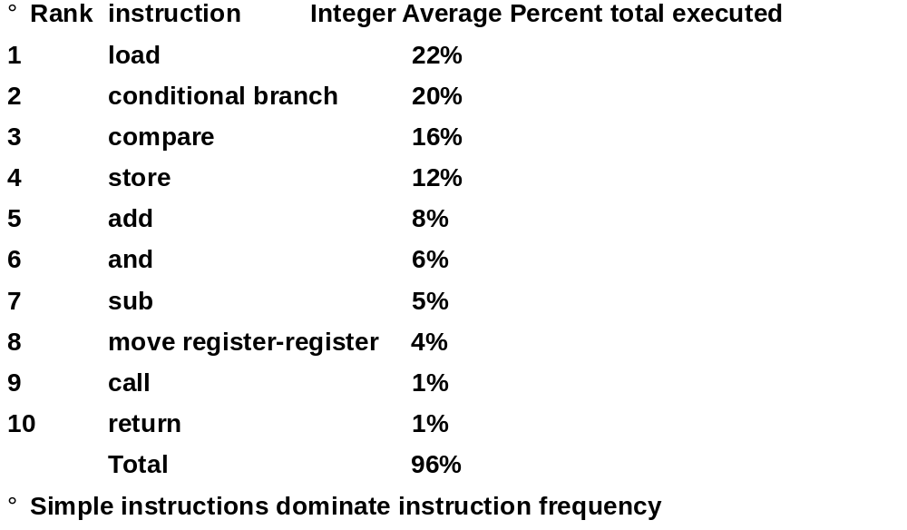
Top 10 80x86 Instructions

Slide 20
Summary
While theoretically we can talk about complicated addressing modes and instructions, the ones we actually use in programs are the simple ones
=> RISC philosophy

Slide 21
Summary: Instruction set design (MIPS)
Use general purpose registers with a load-store architecture: YES
Provide at least 16 general purpose registers plus separate floating-point registers: 31 GPR & 32 FPR
Support basic addressing modes: displacement (with an address offset size of 12 to 16 bits), immediate (size 8 to 16 bits), and register deferred; : YES: 16 bits for immediate, displacement (disp=0 => register deferred)
All addressing modes apply to all data transfer instructions : YES
Use fixed instruction encoding if interested in performance and use variable instruction encoding if interested in code size : Fixed
Support these data sizes and types: 8-bit, 16-bit, 32-bit integers and 32-bit and 64-bit IEEE 754 floating point numbers: YES
Support these simple instructions, since they will dominate the number of instructions executed: load, store, add, subtract, move register-register, and, shift, compare equal, compare not equal, branch (with a PC-relative address at least 8-bits long), jump, call, and return: YES, 16b
Aim for a minimalist instruction set: YES

Slide 22
Instruction Format Field Names
  Fields have names:
  op: basic operation of instruction, “opcode”
  rs: 1st register source operand
  rt: 2nd register source operand
  rd: register destination operand, gets the result
  shamt: shift amount (use later, so 0 for now)
  funct: function; selects the specific variant of the operation in the op field; sometimes called the function code
op
rs
rt
rd
shamt
funct
6 bits
5 bits
5 bits
5 bits
5 bits
6 bits

Slide 23
Notes about Register and Imm. Formats
6 bits
5 bits
5 bits
5 bits
5 bits
6 bits
R:
op
rs
rt
rd
shamt
funct
I:
op
rs
rt
address
6 bits
5 bits
5 bits
16 bits
To make it easier for hardware (HW), 1st 3 fields same in R-format and I-format
Alas, rt field meaning changed
  R-format: rt is 2nd source operand
  I-format: rt can be destination operand
How does HW know which format is which?
  Distinct values in 1st field (op) tell whether last 16 bits are 3 fields (R-format) or 1 field (I-format)

Slide 24
MIPS Addressing Modes/Instruction Formats
All instructions 32 bits wide
Register (direct)
op
rs
rt
rd
register
Immediate
op
rs
rt
immed
Base+index
op
rs
rt
immed
Memory
register
+
PC-relative
op
rs
rt
immed
Memory
PC
+

Slide 25
MIPS Instruction Formats
simple instructions all 32 bits wide
very structured, no unnecessary baggage
only three instruction formats
rely on compiler to achieve performance
— what are the compiler's goals?
help compiler where we can
op rs rt rd shamt funct
R
I
J
op rs rt 16 bit address
op 26 bit address

Slide 26
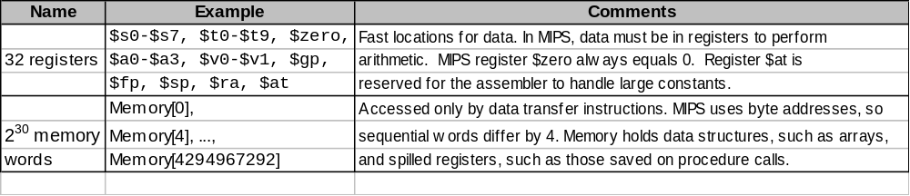
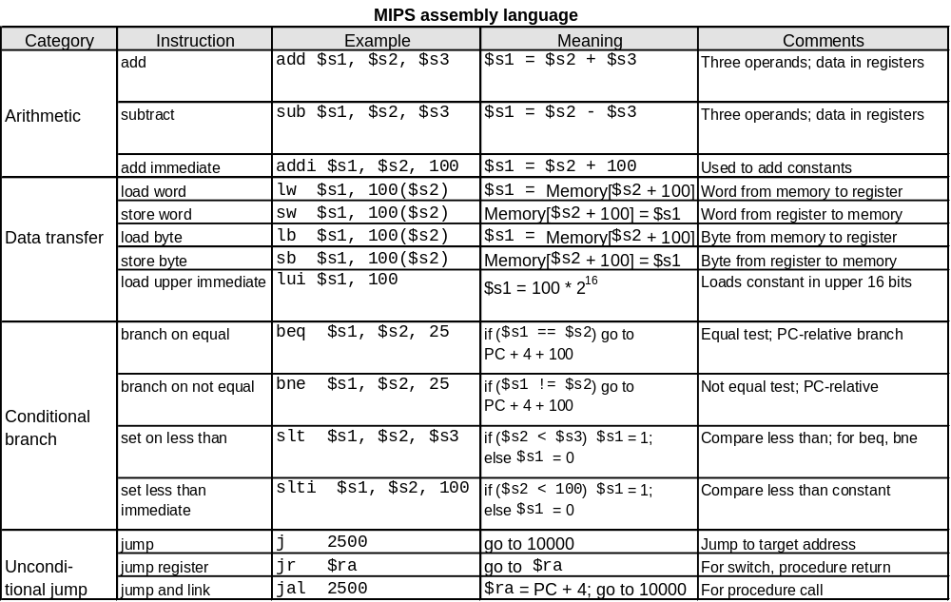
MIPS Instructions:

